Slide 1
Focus for 2016
“Let us fix our eyes on Jesus, the author and perfector of our faith, who for the joy set before him endured the cross, scorning its shame, and sat down at the right hand of the throne of God” (Hebrews 12:2)
1

Slide 2
Focus for 2016
Our focus “let us fix our eyes on Jesus”
1

Slide 3
Focus for 2016
Our focus “let us fix our eyes on Jesus”
Concentration
1

Slide 4
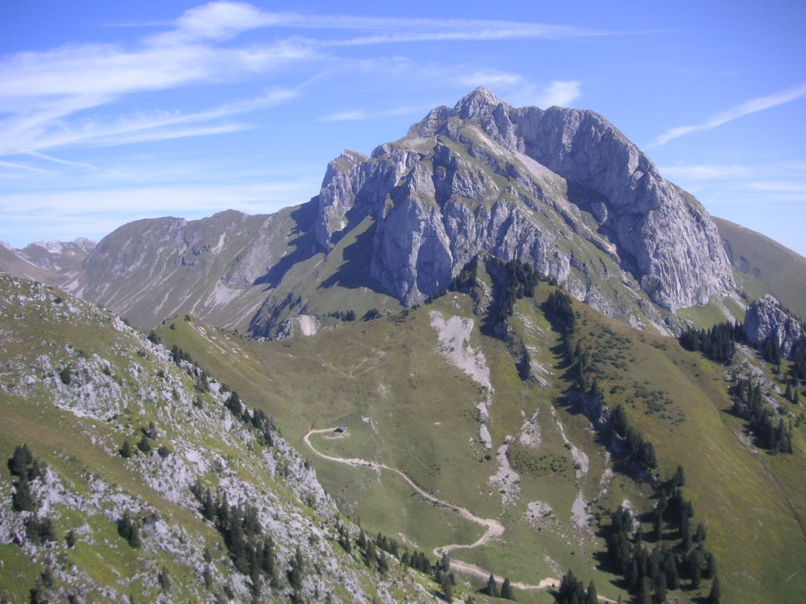
Focus for 2016
Our focus “let us fix our eyes on Jesus”
Concentration
1

Slide 5
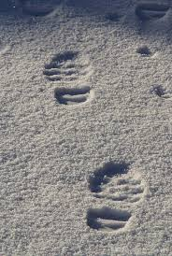
Focus for 2016
Our focus “let us fix our eyes on Jesus”
Concentration
Follow in footsteps
1

Slide 6
Focus for 2016
Our focus “let us fix our eyes on Jesus”
Concentration
Follow in footsteps
Sustained focus
1

Slide 7
Focus for 2016
Our focus “let us fix our eyes on Jesus”
Concentration
Follow in footsteps
Sustained focus
Perseverance necessary
1

Slide 8
Focus for 2016
Our focus “let us fix our eyes on Jesus”
Concentration
Follow in footsteps
Sustained focus
Perseverance necessary
Our sure foundation
“If Christ has not been raised, our faith is futile, we are still in our sins” (1 Cor.15:17)
1

Slide 9
Focus for 2016
Our focus “let us fix our eyes on Jesus”
Concentration
Follow in footsteps
Sustained focus
Perseverance necessary
Our sure foundation
An example of perseverance
« You don’t want to leave too do you?...Lord, to whom shall we go? You have the words of eternal life! (John 6:67-68)
1

Slide 10
Focus for 2016
Our focus “let us fix our eyes on Jesus”
Our example “who, for the joy that was set before him endured the cross, scorning it’s shame” (v.2b)
1

Slide 11
Focus for 2016
Our focus “let us fix our eyes on Jesus”
Our example (alternative translation) “who, instead of/in the place of the joy that was set before him endured the cross, scorning it’s shame” (v.2b)
1

Slide 12
Focus for 2016
Our focus “let us fix our eyes on Jesus”
Our example (alternative translation) “who, instead of/in the place of the joy that was set before him endured the cross, scorning it’s shame” (v.2b)
John Gill: “Christ, instead of being in the bosom of the Father, came into this world; instead of being in the form of God, appeared in the form of a servant; instead of the glory which he had with his Father from eternity, suffered shame and disgrace; instead of a joyful and comfortable life on earth, suffered a shameful and accursed death; instead of the temporal joy and glory the Jews proposed, he endured the shame and pain of the cross.”
1

Slide 13
Focus for 2016
Our focus “let us fix our eyes on Jesus”
Our example (alternative translation) “who, instead of/in the place of the joy that was set before him endured the cross, scorning it’s shame” (v.2b)
Who, being in the very nature of God, did not consider equality with God as something to be grasped, but made himself nothing…, he humbled himself and became obedient to death – even death on a cross! (Phil.2:6-7a, 8b)
1

Slide 14
Focus for 2016
Our focus “let us fix our eyes on Jesus”
Our example (alternative translation) “who, instead of/in the place of the joy that was set before him endured the cross, scorning it’s shame” (v.2b)
Mind-blowing!
1

Slide 15
Focus for 2016
Our focus “let us fix our eyes on Jesus”
Our example (alternative translation) “who, instead of/in the place of the joy that was set before him endured the cross, scorning it’s shame” (v.2b)
How come we’re discontent?
1

Slide 16
Focus for 2016
Our focus “let us fix our eyes on Jesus”
Our example (alternative translation) “who, instead of/in the place of the joy that was set before him endured the cross, scorning it’s shame” (v.2b)
How come we’re discontent?
Sacrifices? What sacrifices?
1

Slide 17
Focus for 2016
Our focus “let us fix our eyes on Jesus”
Our example (alternative translation) “who, instead of/in the place of the joy that was set before him endured the cross, scorning it’s shame” (v.2b)
How come we’re discontent?
Sacrifices? What sacrifices?
What are our goals?
1

Slide 18
Focus for 2016
Our focus “let us fix our eyes on Jesus”
Our example (alternative translation) “who, instead of/in the place of the joy that was set before him endured the cross, scorning it’s shame” (v.2b)
How come we’re discontent?
Sacrifices? What sacrifices?
What are our goals?
Disciples of Christ? Follow me!
1

Slide 19
Focus for 2016
Our focus “let us fix our eyes on Jesus”
Our example
Our hope “…and sat down at the right hand of the throne of God.”
1

Slide 20
Focus for 2016
Our focus “let us fix our eyes on Jesus”
Our example
Our hope “…and sat down at the right hand of the throne of God.”
Finished work
1

Slide 21
Focus for 2016
Our focus “let us fix our eyes on Jesus”
Our example
Our hope “…and sat down at the right hand of the throne of God.”
Finished work
Supreme position
1

Slide 22
Focus for 2016
Our focus “let us fix our eyes on Jesus”
Our example
Our hope “…and sat down at the right hand of the throne of God.”
Finished work
Supreme position
No abdication
1

Slide 23
Focus for 2016
Our focus “let us fix our eyes on Jesus”
Our example
Our hope “…and sat down at the right hand of the throne of God.”
Finished work
Supreme position
No abdication
Exalted one
1

Slide 24
Focus for 2016
Our focus “let us fix our eyes on Jesus”
Our example
Our hope “…and sat down at the right hand of the throne of God.”
Finished work
Supreme position
No abdication
Exalted one
Guarantor of our arrival
1

Slide 25
Focus for 2016
Our focus “let us fix our eyes on Jesus”
Our example
Our hope “…and sat down at the right hand of the throne of God.”
Finished work
Supreme position
No abdication
Exalted one
Guarantor of our arrival
“On the victory side”
1

Slide 26
Focus for 2016
Our focus “let us fix our eyes on Jesus”
Our example
Our hope “…and sat down at the right hand of the throne of God.”
Words of encouragement:
1

Slide 27
Focus for 2016
Our focus “let us fix our eyes on Jesus”
Our example
Our hope “…and sat down at the right hand of the throne of God.”
Words of encouragement:
All in a race
1

Slide 28
Focus for 2016
Our focus “let us fix our eyes on Jesus”
Our example
Our hope “…and sat down at the right hand of the throne of God.”
Words of encouragement:
All in a race
Keep eyes on Jesus
1

Slide 29
Focus for 2016
Our focus “let us fix our eyes on Jesus”
Our example
Our hope “…and sat down at the right hand of the throne of God.”
Words of encouragement:
All in a race
Keep eyes on Jesus
In God’s eyes, we’re already winners!
1

